Slide 1
OTHER ALGORITHMS APPLIED
BY
P.ROOPA

Slide 2
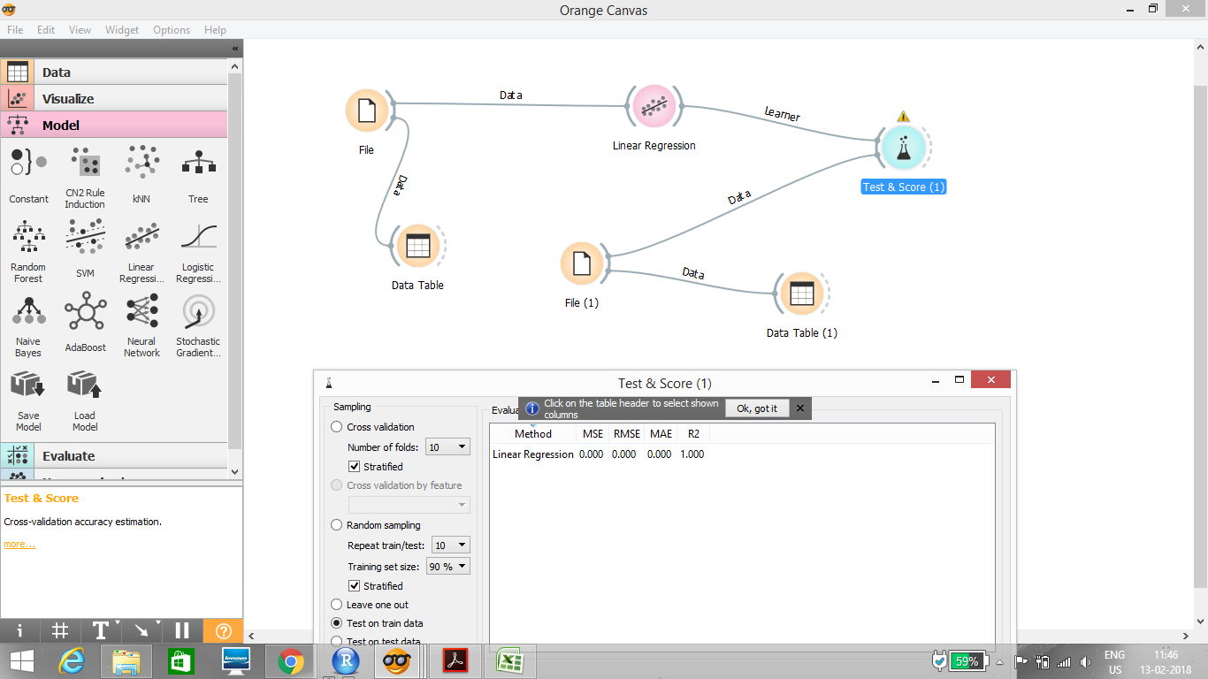

Slide 3
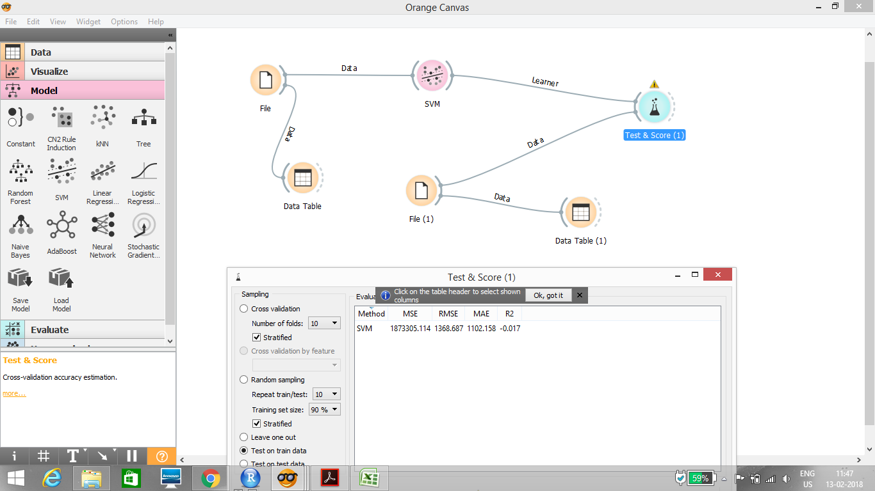

Slide 4
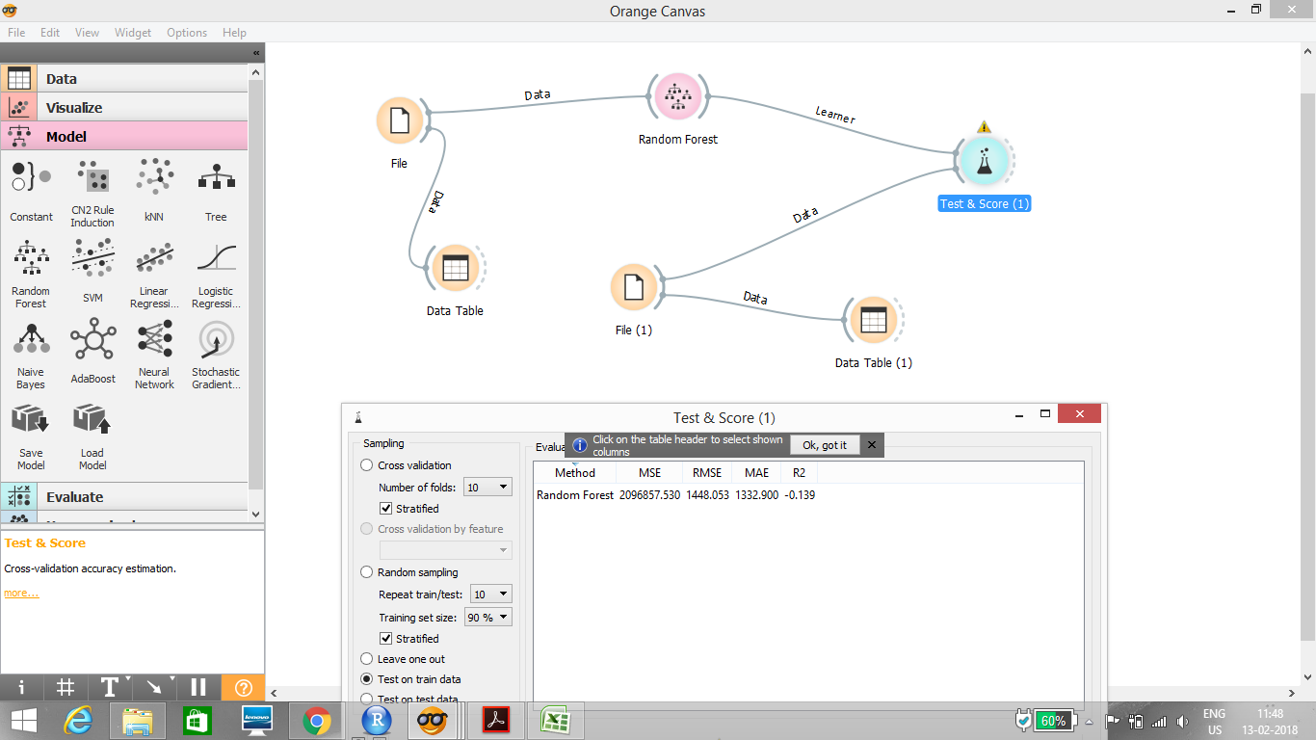

Slide 5
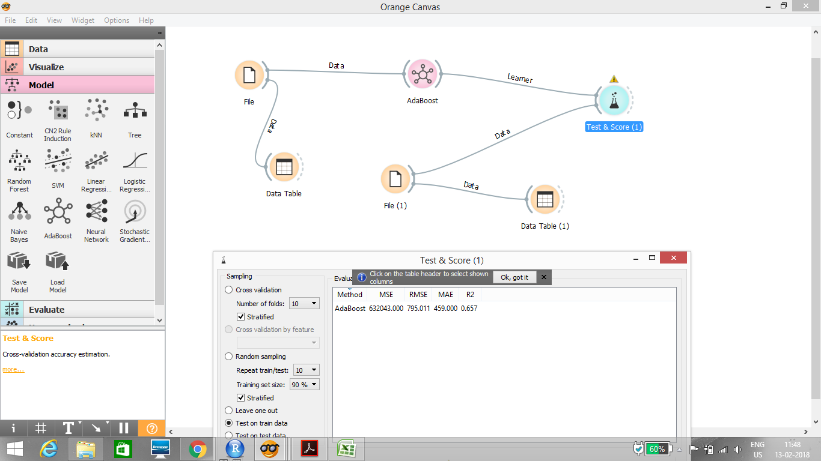

Slide 6
